Slide 1
3D Plot 14주차_01_13
한 동 대 학 교 김경미 교수

Slide 2
학습목표
Three-dimensional Plotting
3D Contour Plot
3D Wireframe Plot
3D Surface Plot

Slide 3
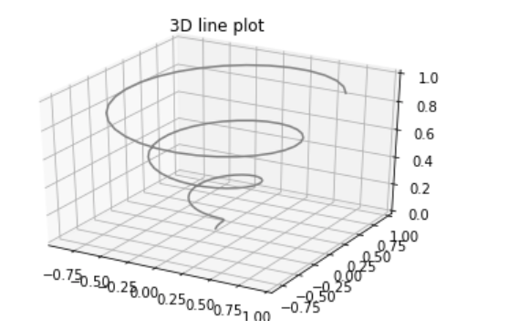
Three-dimensional Plotting 1
3차원 plot을 가능하게 함
from mpl_toolkits import mplot3d
import numpy as np
import matplotlib.pyplot as plt
fig = plt.figure()
ax = plt.axes(projection='3d')
z = np.linspace(0, 1, 100)
x = z * np.sin(20 * z)
y = z * np.cos(20 * z)
ax.plot3D(x, y, z, 'gray')
ax.set_title('3D line plot')
plt.show()

Slide 4
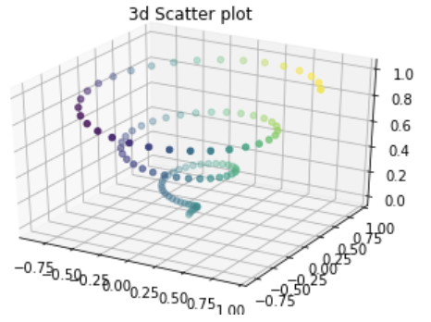
Three-dimensional Plotting 2
from mpl_toolkits import mplot3d
import numpy as np
import matplotlib.pyplot as plt
fig = plt.figure()
ax = plt.axes(projection='3d')
z = np.linspace(0, 1, 100)
x = z * np.sin(20 * z)
y = z * np.cos(20 * z)
c = x + y
ax.scatter(x, y, z, c=c)
ax.set_title('3d Scatter plot')
plt.show()

Slide 5
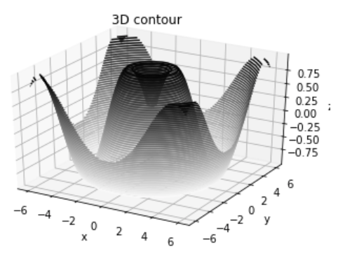
3D Contour Plot
from mpl_toolkits import mplot3d
import numpy as np
import matplotlib.pyplot as plt
def f(x, y):
return np.sin(np.sqrt(x ** 2 + y ** 2))
x = np.linspace(-6, 6, 30)
y = np.linspace(-6, 6, 30)
X, Y = np.meshgrid(x, y)
Z = f(X, Y)
fig = plt.figure()
ax = plt.axes(projection='3d')
ax.contour3D(X, Y, Z, 50, cmap='binary')
ax.set_xlabel('x')
ax.set_ylabel('y')
ax.set_zlabel('z')
ax.set_title('3D contour')
plt.show()

Slide 6
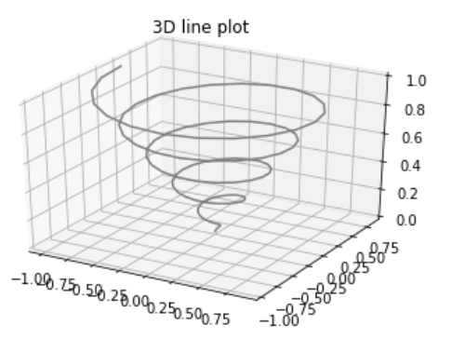
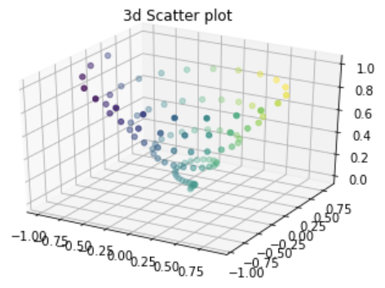
연습문제 1
위 그림에서 아래그림으로 결과 내고자 할때 빈칸에 들어갈 알맞은 표현은?
from mpl_toolkits import mplot3d
import numpy as np
import matplotlib.pyplot as plt
fig = plt.figure()
ax = plt.axes(projection='3d')
z = np.linspace(0, 1, 100)
x = z * np.sin(30 * z)
y = z * np.cos(30 * z)
ax.set_title('3d Scatter plot')
plt.show()

Slide 7
연습문제 1 답안
from mpl_toolkits import mplot3d
import numpy as np
import matplotlib.pyplot as plt
fig = plt.figure()
ax = plt.axes(projection='3d')
z = np.linspace(0, 1, 100)
x = z * np.sin(30 * z)
y = z * np.cos(30 * z)
ax.set_title('3d Scatter plot')
plt.show()
c = x + y
ax.scatter(x, y, z, c=c)

Slide 8
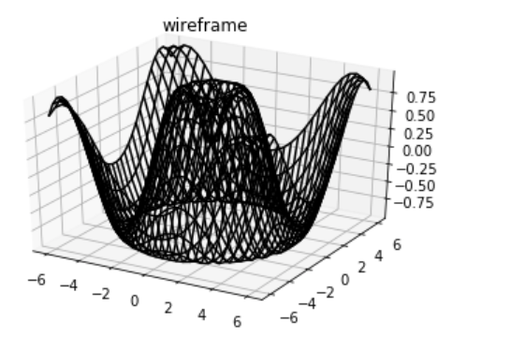
3D Wireframe Plot
from mpl_toolkits import mplot3d
import numpy as np
import matplotlib.pyplot as plt
def f(x, y):
return np.sin(np.sqrt(x ** 2 + y ** 2))
x = np.linspace(-6, 6, 30)
y = np.linspace(-6, 6, 30)
X, Y = np.meshgrid(x, y)
Z = f(X, Y)
fig = plt.figure()
ax = plt.axes(projection='3d')
ax.plot_wireframe(X, Y, Z, color='black')
ax.set_title('wireframe')
plt.show()

Slide 9
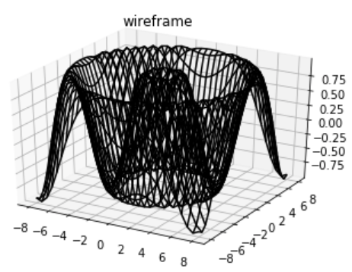
연습문제 2
다음과 같은 결과를 내기 위해 코드에 알맞은 표현을 써라
from mpl_toolkits import mplot3d
import numpy as np
import matplotlib.pyplot as plt
def f(x, y):
return np.sin(np.sqrt(x ** 2 + y ** 2))
x =
y =
X, Y = np.meshgrid(x, y)
Z = f(X, Y)
fig = plt.figure()
ax = plt.axes(projection='3d’)
ax.set_title('wireframe')
plt.show()

Slide 10
연습문제 2 답안
from mpl_toolkits import mplot3d
import numpy as np
import matplotlib.pyplot as plt
def f(x, y):
return np.sin(np.sqrt(x ** 2 + y ** 2))
x =
y =
X, Y = np.meshgrid(x, y)
Z = f(X, Y)
fig = plt.figure()
ax = plt.axes(projection='3d’)
ax.set_title('wireframe')
plt.show()
np.linspace(-8, 8, 30)
np.linspace(-8, 8, 30)
ax.plot_wireframe(X, Y, Z, color='black')

Slide 11
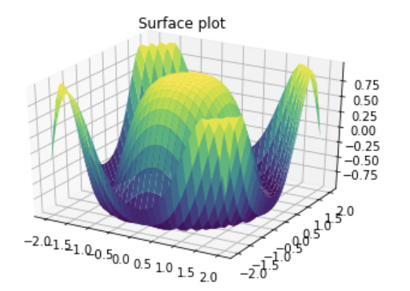
3D Surface Plot
from mpl_toolkits import mplot3d
import numpy as np
import matplotlib.pyplot as plt
x = np.outer(np.linspace(-2, 2, 30), np.ones(30))
y = x.copy().T # transpose
z = np.cos(x ** 2 + y ** 2)
fig = plt.figure()
ax = plt.axes(projection='3d')
ax.plot_surface(x, y, z,cmap='viridis', edgecolor='none')
ax.set_title('Surface plot')
plt.show()

Slide 12
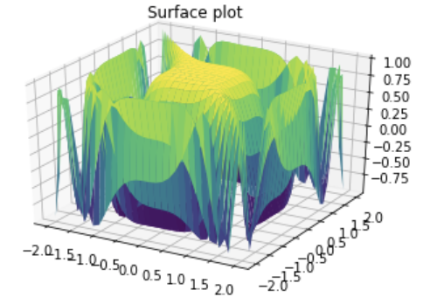
연습문제 3
다음과 같은 그림을 plot하기 위한 적절한 함수 표현은?
1. scatter()
2. plot_wireframe()
3. plot_surface()
4. plot_wireframe()

Slide 13
연습문제 3 답안
1. scatter()
2. plot_wireframe()
3. plot_surface()
4. plot_wireframe()

Slide 14
Reference
https://www.tutorialspoint.com/matplotlib/matplotlib_jupyter_notebook.htm
https://www.w3schools.com/python/matplotlib_intro.asp
https://matplotlib.org/stable/index.html
https://realpython.com/python-matplotlib-guide/
https://datascienceschool.net/01%20python/05.02%20%EB%A7%B7%ED%94%8C%EB%A1%AF%EB%A6%AC%EB%B8%8C%EC%9D%98%20%EC%97%AC%EB%9F%AC%EA%B0%80%EC%A7%80%20%ED%94%8C%EB%A1%AF.html

Slide 15
강의 요약
Three-dimensional Plotting
3D Contour Plot
3D Wireframe Plot
3D Surface Plot

Slide 16
목표 달성 질문
3차원 plot을 그릴 때 사용하는 함수명을 2가지 기술하시오

Slide 17
감사합니다
14주차_01_13 3D Plot

